Slide 1

Capstone Project
By: Jerry Mai

Slide 2
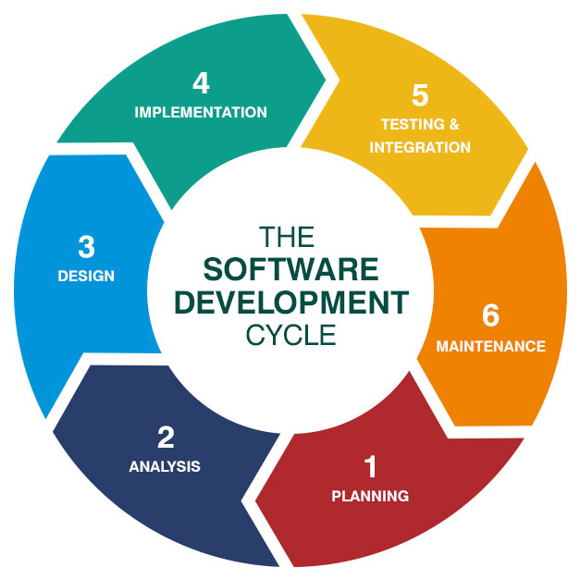
Software Development Life Cycle
Planning: Think about what you want to do and make a plan.
Analysis: Check if your plan is realistic and makes sense.
Design: Make detailed plans for how the software will work.
Implementation: Write the actual computer code based on the plans.
Testing & Integration: Check if the software works correctly and put all the pieces together.
Maintenance: Keep an eye on the software, fix any problems, and make improvements over time.

Slide 3
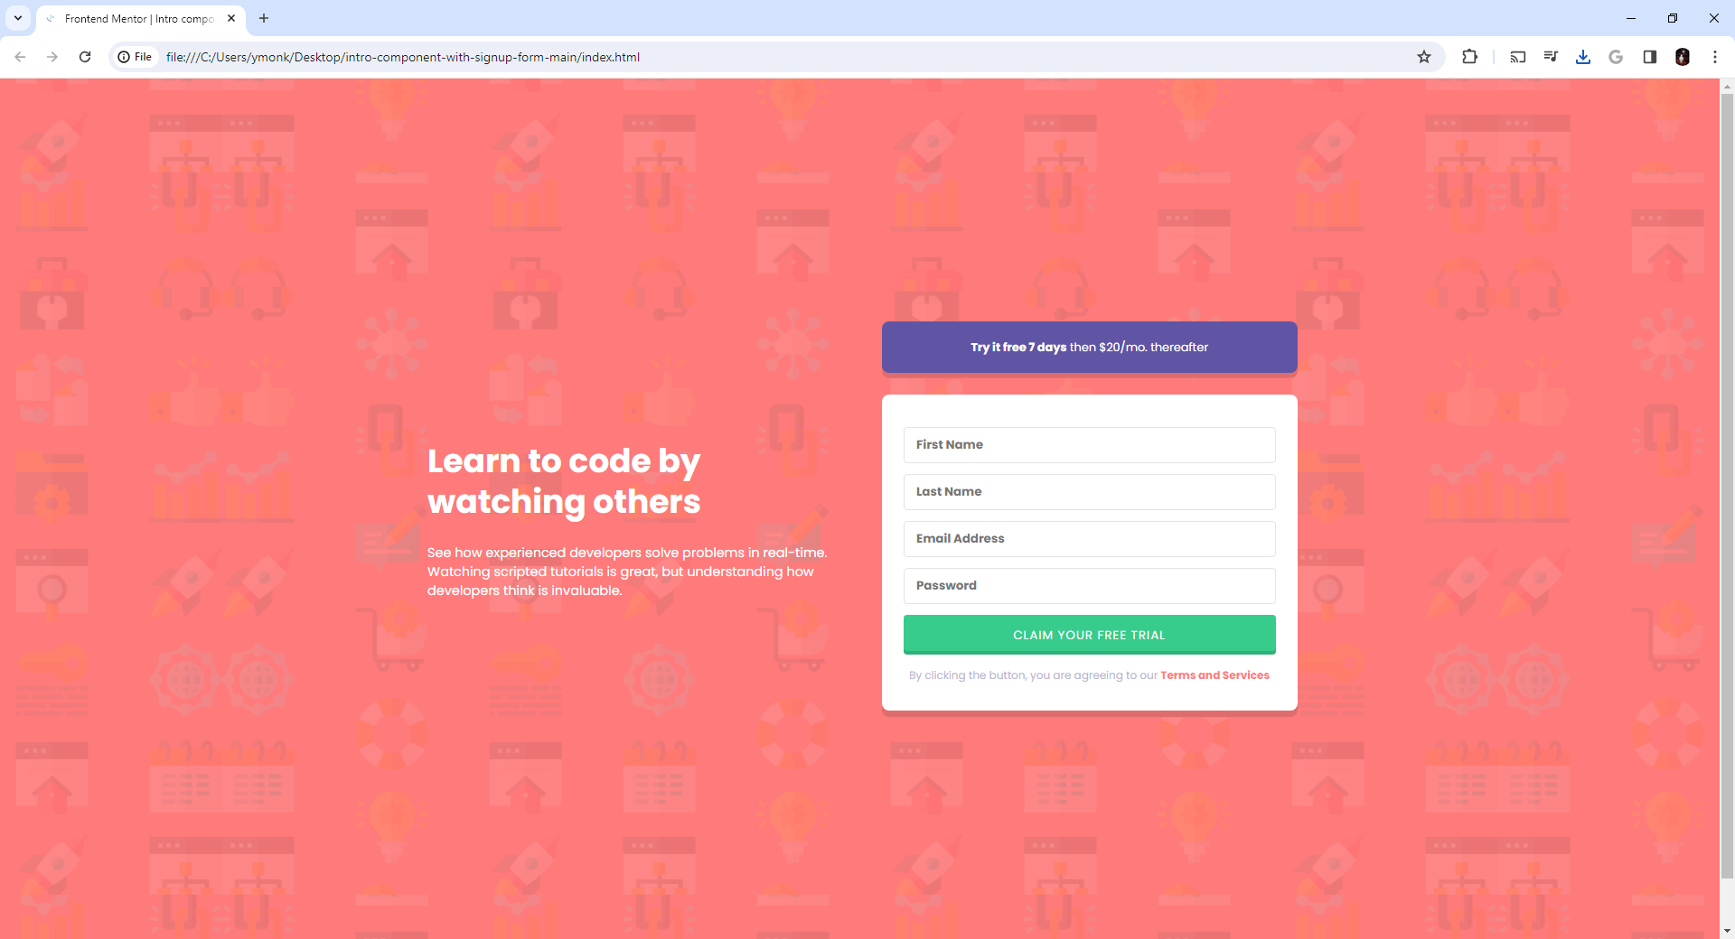
Intro-Component with Signup Form

Slide 4
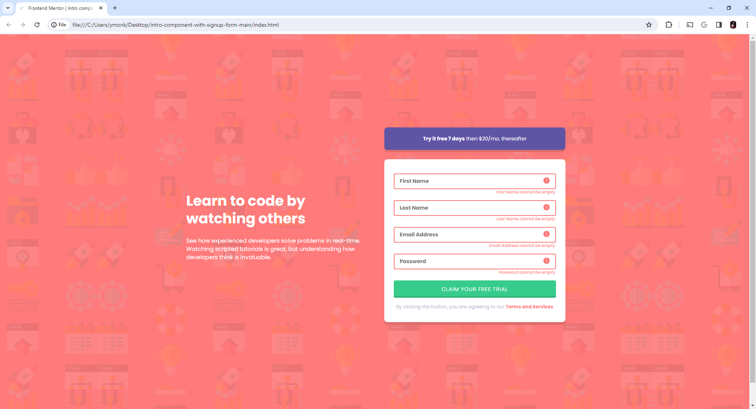
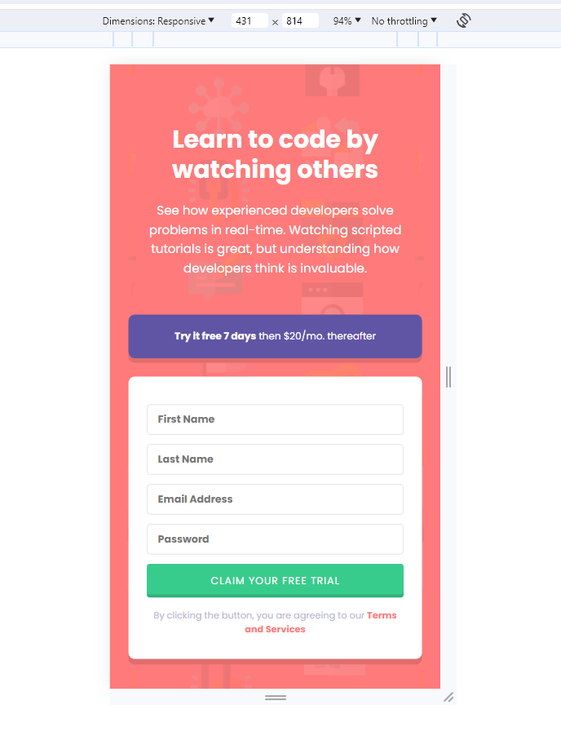
Original Idea
Desktop View
Mobile View

Slide 5
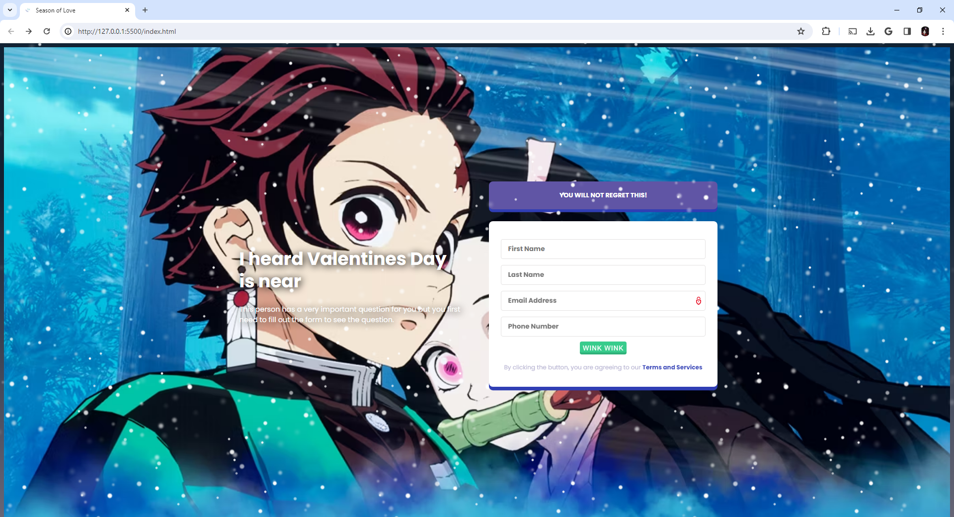
https://onetonwonton.github.io/JSCapstone/
https://659cb7ec37ee755ab35f30ea--inspiring-eclair-c70cd4.netlify.app/

Slide 6


Thank You!
Jerry Mai
Jmai@nyc.yearup.org
347-458-2470

